Slide 1
Introduction

Slide 2
Lesson Objectives
After completing this lesson, you should be able to do the following:
Describe the Oracle implementation of the RDBMS and ORDBMS
Understand the goals of the course

Slide 3
Lesson Agenda
Basic of database
Introduction to program Oracle
Install program Oracle: sqldeveloper
Unlocked hr user

Slide 4
Lesson Agenda
Basic of database
Introduction to program Oracle
Install program Oracle: sqldeveloper
Unlocked hr user

Slide 5
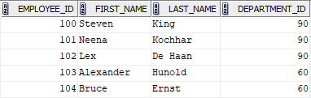
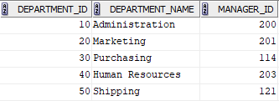
Relating Multiple Tables
Each row of data in table is uniquely identified by a Primary Key (PK).
You can logically relate data from multiple tables using Foreign Key (FK).
Table: Employees
Table: Departments
Primary Key
Foreign Key
Primary Key

Slide 6
Relational Database Properties
A relational Database:
Can be accessed and modified by executing structured query language (SQL) statements.
Contains a collections of tables with no physical pointer.
Uses a set of operators.

Slide 7
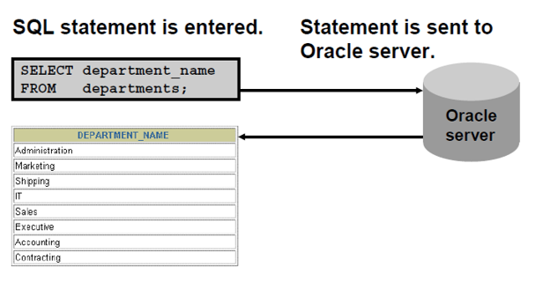
Communicating with an RDBMS Using SQL

Slide 8
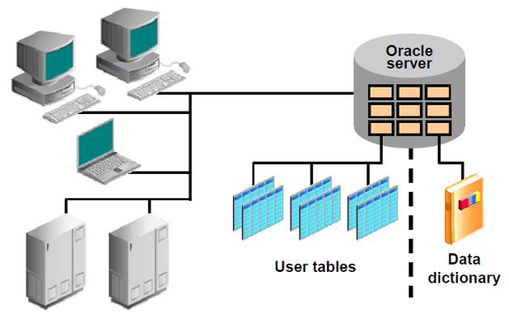
Oracle’s Relational Database Management System

Slide 9
SQL Statement
Data Manipulation Language (DML) | SELECT INSERT UPDATE DELETE MERGE
Data Definition Language (DDL) | CREATE ALTER DROP RENAME TRUNCATE COMMENT
Data Control Language (DCL) | GRANT REVOKE
Transaction Control | COMMIT ROLLBACK SAVEPOINT

Slide 10
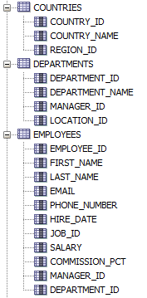
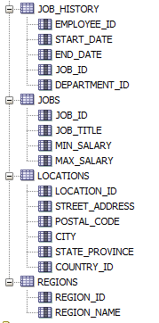
Tables Used in the Course
COUNTRIES
DEPARTMENTS
EMPLOYEES
JOB_HISTORY
JOBS
LOCATIONS
REGIONS

Slide 11
Lesson Agenda
Basic of database
Introduction to program Oracle
Install program Oracle: sqldeveloper
Unlocked hr user

Slide 12
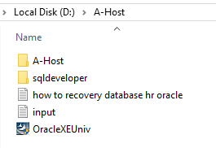
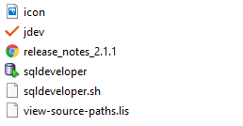
Start Program SQL Developer
Open Drive D:\
Open Folder A-Host
Open Folder sqldeveloper
Open Program sqldeveloper

Slide 13
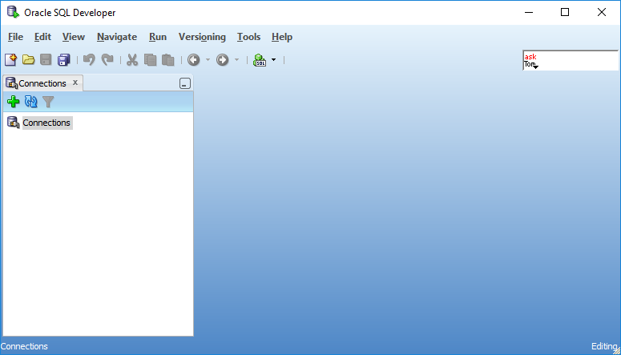
sqldeveloper Interface
You must define a connection to start using SQL Developer for running SQL queries on a database schema.

Slide 14
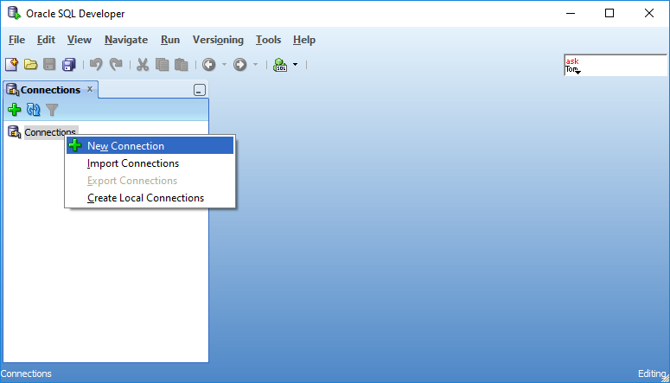
Create a Database Connection
1. Right-Click on Connections
2. Choose New Connection
or
Click button on the top

Slide 15
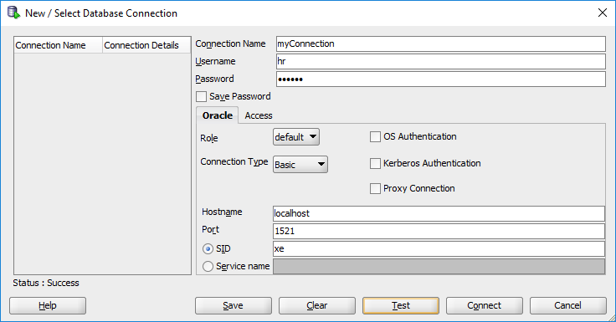
Create a Database Connection
1
Username: hr
Password: oracle
3
2
4

Slide 16
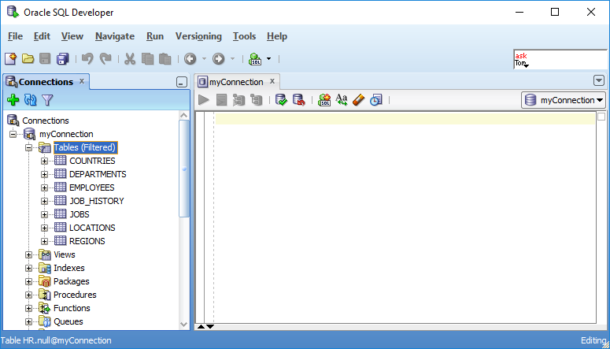
Create a Database Connection
Connect Success
Space for Writing
SQL statements

Slide 17
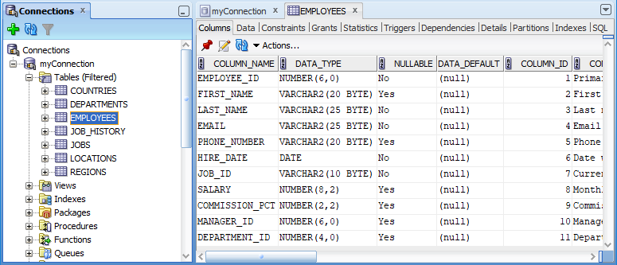
Browsing Database Objects
Using the Connections Navigator to:
Browse through many objects in a database schema
Review the definitions of objects at a glance
2
1

Slide 18
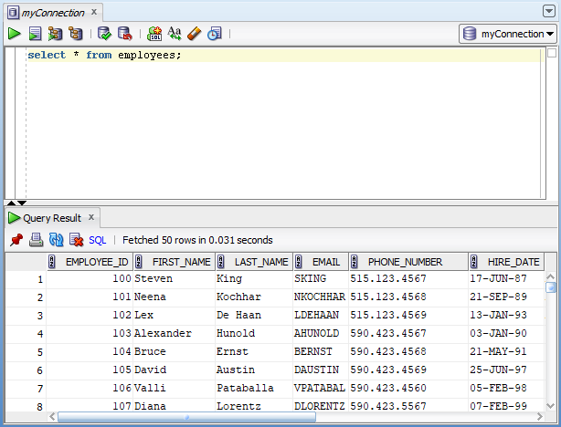
Using SQL Worksheet
Use the SQL Worksheet to enter and execute SQL, PL/SQL and SQL*Plus statements.
Specify any actions that can be processed by the database connection associated with the worksheet.
Enter SQL statements.
Results are shown here.

Slide 19
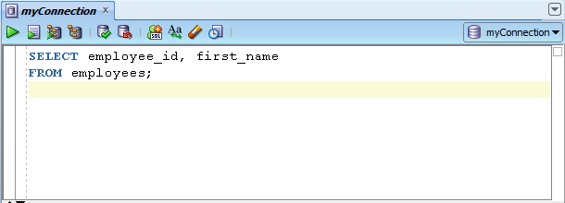
Using SQL Worksheet
SELECT employee_id, first_name
FROM employees;

Slide 20
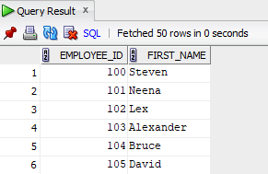
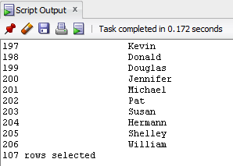
Executing SQL Statements
Use the Enter SQL Statement box to enter single or multiple SQL Statements.
F9
F5
Result from F9 Key
Result from F5 Key

Slide 21
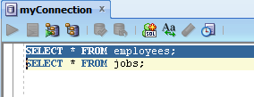
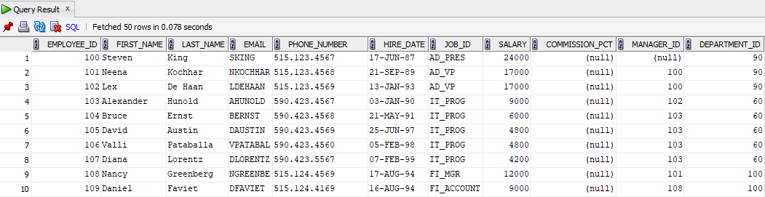
Executing SQL Statements (F9)
In the case of multiple queries. If you want to display any order to cover the command you want and press F9 to display the data from the table, such as employees.

Slide 22
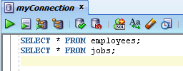
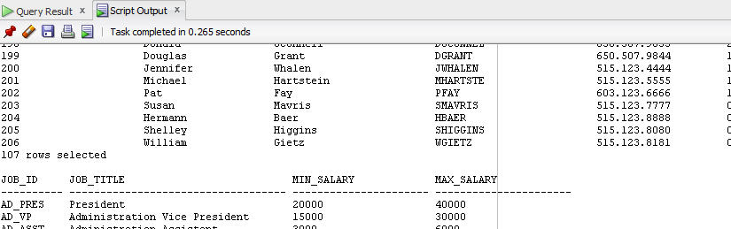
Executing SQL Statements (F5)
Executing SQL by pressing F5 and select the command you want to display all the commands that are written.

Slide 23
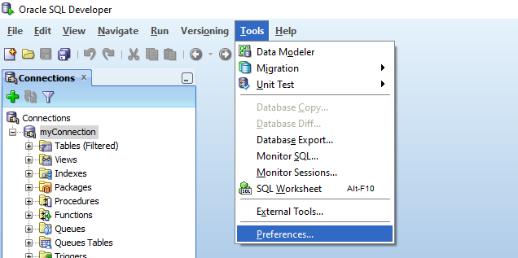
Setting Preferences
Customize the SQL Developer interface and environment.
In the Tools menu, select Preferences.
1
2

Slide 24
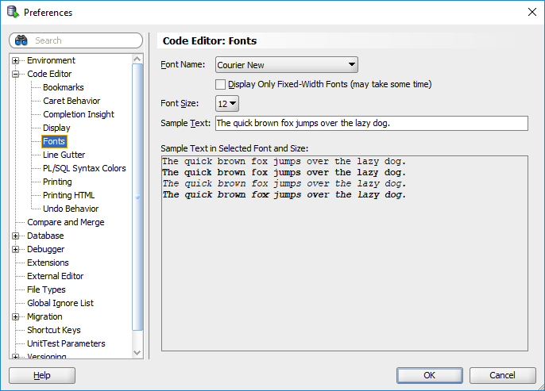
Setting Preferences (Font Setting)
3
1
2
4

Slide 25
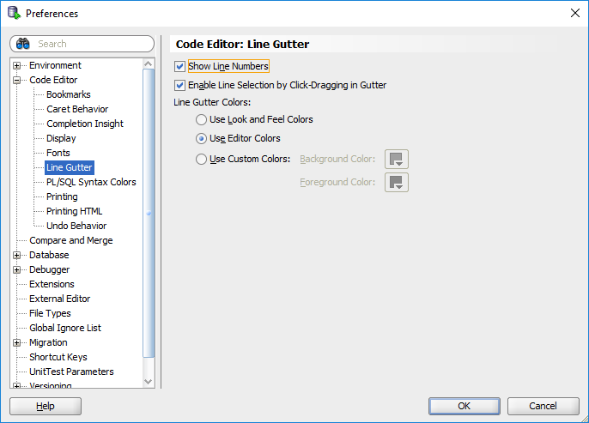
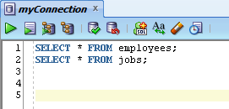
Setting Preferences
The line numbers when writing SQL commands on the screen.
3
1
2
5
4

Slide 26
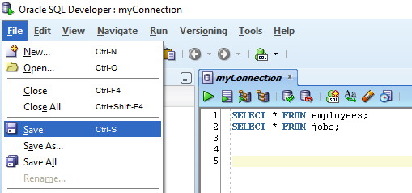
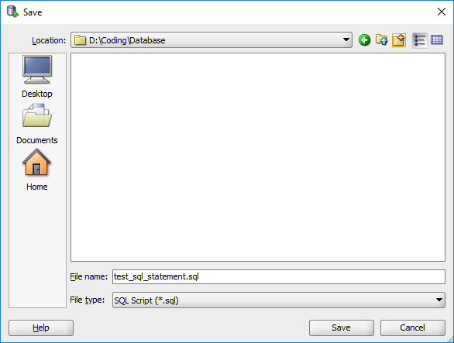


Saving SQL Statements
1
3
2
6
File in type .sql
7
4
5

Slide 27
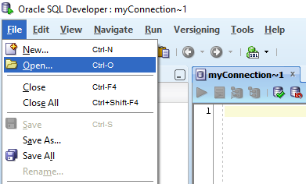
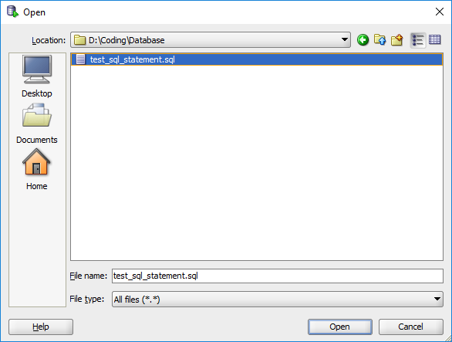
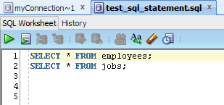
Open Script Files
1
2
Choose Location
3
4
Choose file
6
5

Slide 28
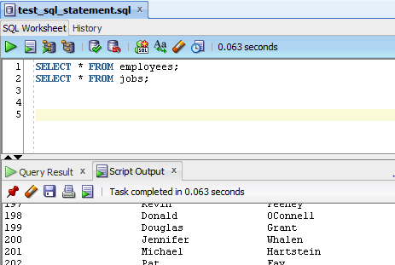
Delete SQL Statements
Delete SQL Statements
Delete Script Output

Slide 29
Lesson Agenda
Basic of database
Introduction to program Oracle
Install program Oracle: sqldeveloper
Unlocked hr user

Slide 30
Install program Oracle: sqldeveloper
Copy folder A-Host from TNI.
Paste folder A-Host in drive D:\ to your computer.
Open program same as step in Start Program SQL Developer
For the first time, must unlock hr user.

Slide 31
Lesson Agenda
Basic of database
Introduction to program Oracle
Install program Oracle: sqldeveloper
Unlocked hr user

Slide 32
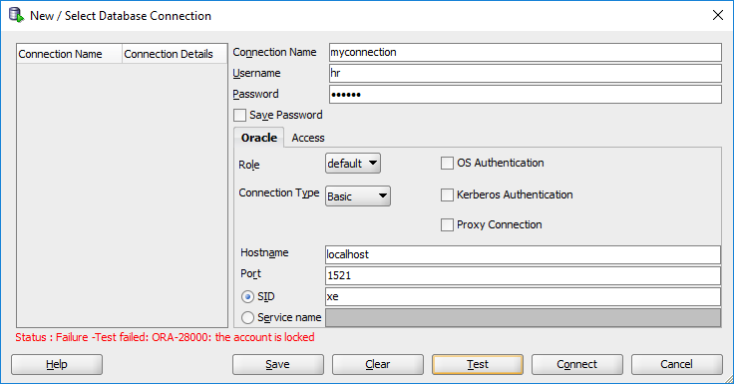
Unlocked hr user
Error account user hr locked.

Slide 33
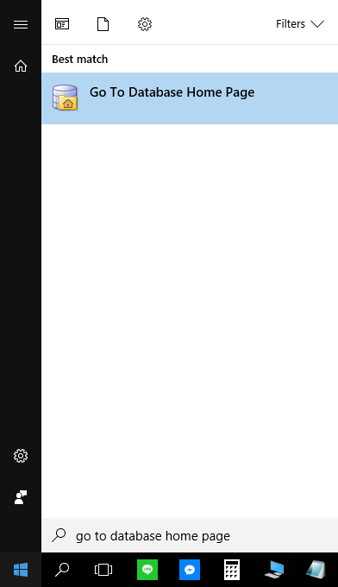
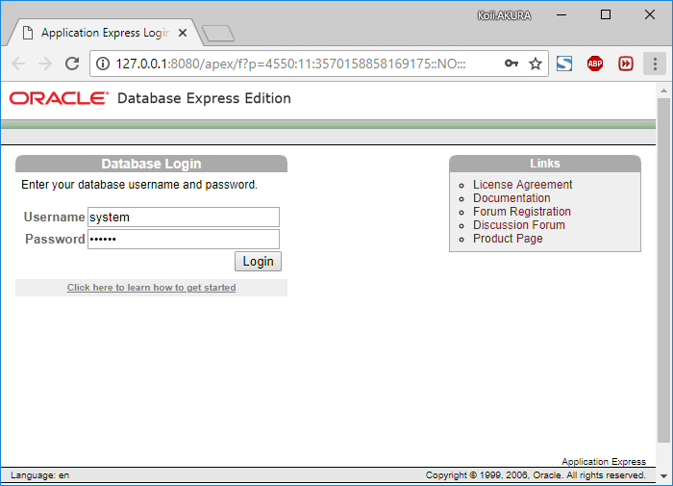
Unlocked hr user
Search word "Go To Database Home Page" on Windows button.
Username: system
Password: oracle

Slide 34
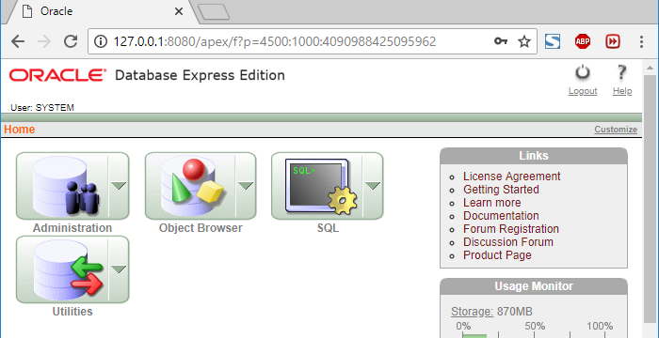
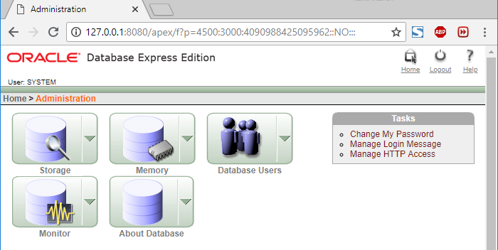
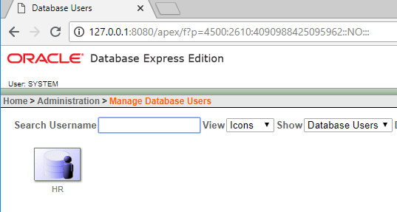
Unlocked hr user
Interface Database Homepage.
Click Administration >> Database Users >> HR.
2
1
3

Slide 35
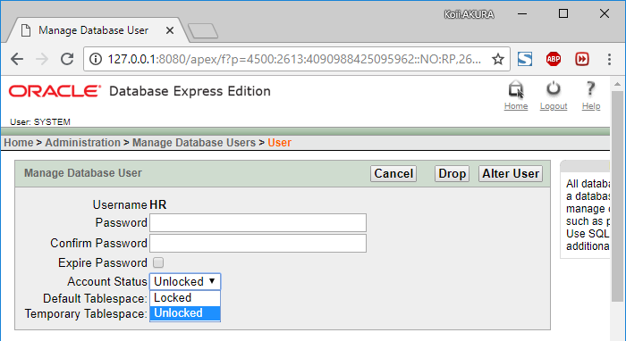
Unlocked hr user
At Account Status choose Unlocked.
Click Alter User button.
2
For the first time, should set password: oracle
1

Slide 36
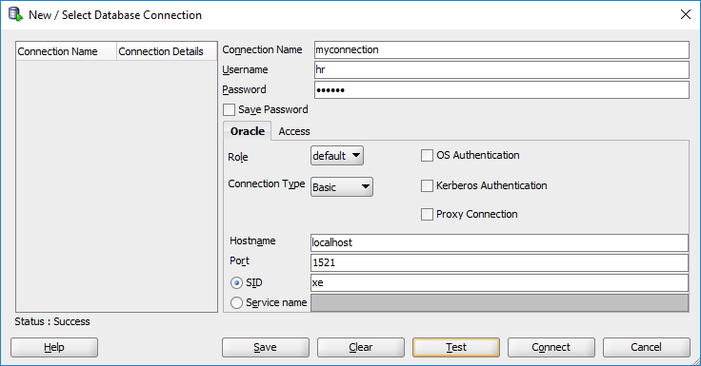
Unlocked hr user
After unlocked user hr.

